Slide 1
Telemetry & Real-Time Analytics

Slide 2
Telemetry & Real-Time Analytics
Telemetry & Real-Time Analytics
Telemetry is the automatic collection and transmission of data from a vehicle’s sensors to a central system or cloud, allowing real-time monitoring and alerts without someone being inside the vehicle.
why we need Telemetry?
With Cloud | Without Cloud
Data is monitored remotely | Data is seen only once inside the vehicle
Problems are detected early | Problems are detected late
Data is stored for future use | Data is not stored
Maintenance is planned | Maintenance happens after failure
Many vehicles can be monitored | Only one vehicle can be monitored

Slide 3
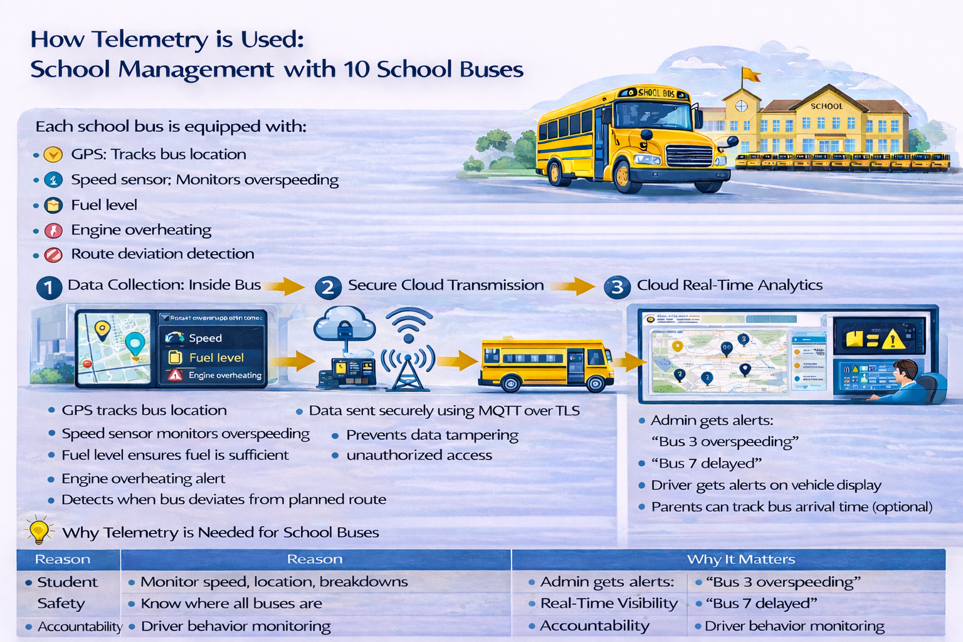
Telemetry & Real-Time Analytics

Slide 4
Telemetry & Real-Time Analytics
How Telemetry is Implemented in 4-Wheelers
Sensors & CAN Bus:
  Vehicles have multiple sensors (engine temperature, battery, fuel, tire pressure, GPS).
  Sensors communicate via the CAN bus (Controller Area Network), the automotive standard for in-vehicle communication.
Edge Processing (ECU / TCU):
  A Telematics Control Unit (TCU) or ECU collects CAN signals.
  Implements a rule engine and state machine to detect important events (e.g., battery overheating, low fuel, tire pressure drop).
  Only critical events are transmitted to reduce bandwidth.
Secure Transmission:
  Data is sent to cloud platforms using MQTT over TLS or HTTPS, ensuring encryption and authentication.
Cloud Analytics & Dashboard:
  Real-time analytics processes telemetry from multiple vehicles.
  Fleet operators or OEMs get alerts, predictive maintenance notifications, and performance insights.
  In-vehicle HMI/cluster displays critical warnings to the driver.

Slide 5
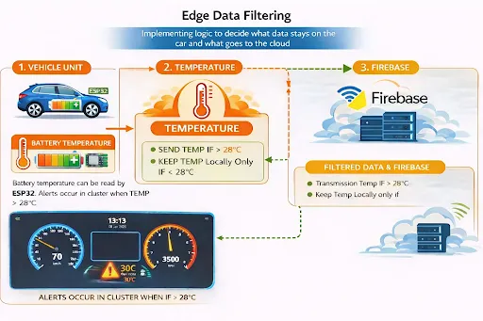
Telemetry & Real-Time Analytics
Components using in Telemetry POC
ESP32 – reads and processes sensor data
Temperature Sensor – measures temperature
Wi-Fi – sends data to the cloud
Firebase – stores and updates data
Qt Simulation – displays temperature and alerts
Telemetry & Real-Time Analytics – In OKT507-C
A temperature sensor is connected to an ESP32
ESP32 reads the temperature continuously
A 28°C threshold is defined in the ESP32 code
ESP32 sends temperature data to Firebase using Wi-Fi
Firebase updates the data in real time
A Qt application displays temperature values and alert messages

Slide 6
Telemetry & Real-Time Analytics
Aspect | Industrial-Standard Telemetry | Current OKT507-C Setup (POC using Firebase)
Communication | Sensors communicate via CAN bus (automotive standard) | Temperature sensor directly connected to ESP32 (GPIO)
Processing Unit | ECU / TCU (Linux-based) with rule engine & state machine | ESP32 with simple threshold logic
Data Filtering | Edge filtering – only important events sent | Continuous data sent to Firebase and whenever alerts occurs it will be stored in database.
Cloud Platform | Industrial IoT Cloud (AWS IoT / Azure IoT / GCP IoT) | Firebase Realtime Database
Scalability & Analytics | Fleet-level analytics, predictive maintenance | Single-device view, basic real-time alerts

Slide 7
THANK YOU

